Slide 1
Integrating IP in Multicore DSP/Processor SoCs
Jonah Probell, Director of Multimedia Solutions, ARC International

Slide 2
Multicore Considerations
Speed (instances required)
Area (code density and data gymnastics)
Power (logic efficiency)
RISC (control decision) / SIMD (data vector) processing balance
Accelerators
DMA controllers
Programming Model
Software tool chain

Slide 3
An Optimal Architecture
Hardware acceleration
RISC core
Programmed linearly in high-level languages
One or more media-optimized vector SIMD engines
Inner-loop functions
programmed in assembly as linear macros
ARC® 750D CPU
ARC® Video SIMD Core
DMA-assisted VLC decoder
SCM
ARC® 750D CPU
Media Processor
8- x 16-bit Data
(pixel processing)
SCQ
SCQ
SDM
Instruction
cache
Data
cache
128-bit wide SDM
DMA Engine
Video DMA
2-dimensional video optimized DMA controller

Slide 4
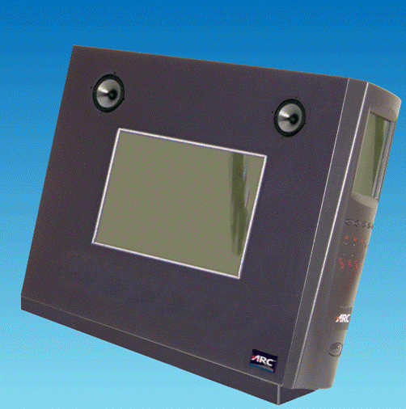
ARC Video
95 MHz FPGA demo
  Linux (MMU)
  Audio
  Video
  SDTV decode
600 MHz in Silicon
  44 mW H.264 decode
  < 3 mm² die size
  All major codecs
    About 20
VGA output
touch-screen display

Slide 5
Video Pixel Processing Pipeline
SIMD
RISC
DMA
RAM
RISC
RAM
SIMD
RAM
RISC
RISC
RISC
SIMD
RAM
SIMD
RAM
SIMD
SIMD
SIMD
RAM
DMA
RISC
RISC
RAM
RISC
RISC
RISC
SIMD
RISC
SIMD
RAM
SIMD
SIMD
SIMD
RAM
SIMD
SIMD
RAM
SIMD
SIMD

Slide 6
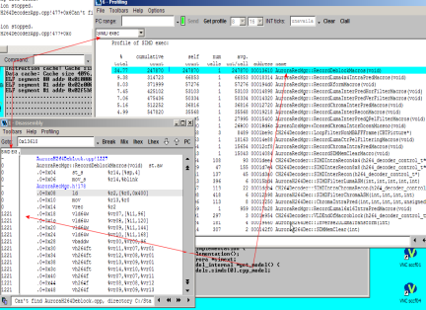
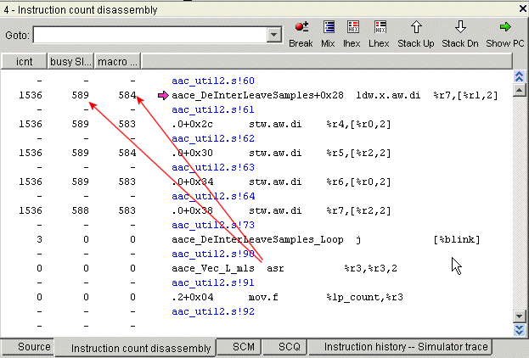
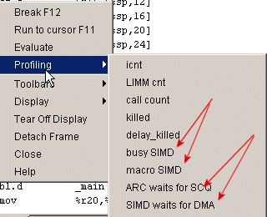
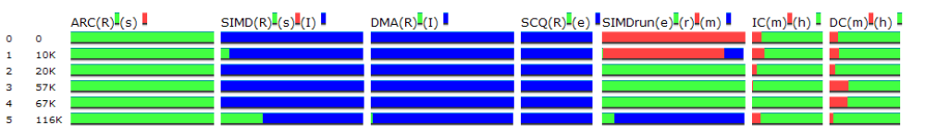
Tools for VRaptor Code Development
Application profiling
Streaming Media Application
Program partitioning and parallelisation
High Speed Simulation
Stream DMA
Input filter
Scratch Pad RAM
Instruction execution statistics
Refinement
Hardware Accel.
ARC® 750D CPU
Media Processor
Stream DMA
Output filter
Media DMA
Highlight hotspots or parallelisation issues
Select information to monitor during simulation
Activity charts illustrate busy / Idle time, cache stats and SCQ occupancy

Slide 7
What NOT to use for DSP Projects
Fully hardwired cores
Wide VLIWs
Homogenous multiprocessors

Slide 8
Conclusion
Consider your IP vendor
  Size, Stability, Openness, Commitment to the market
  Watch what other chip companies are doing
Consider the system architecture
  Don’t forget the host processor and operating system
Use your application knowledge
  Don’t buy a tool to replace your DSP chip or software designers
Limit your integration issues by buying from a single vendor
  You can get everything that you need from ARC
  Except for your proprietary competitive advantage

Slide 9


